Slide 1
Virtual Fashion Mirror
Presented By
Sakshi S. Kadam

Slide 2
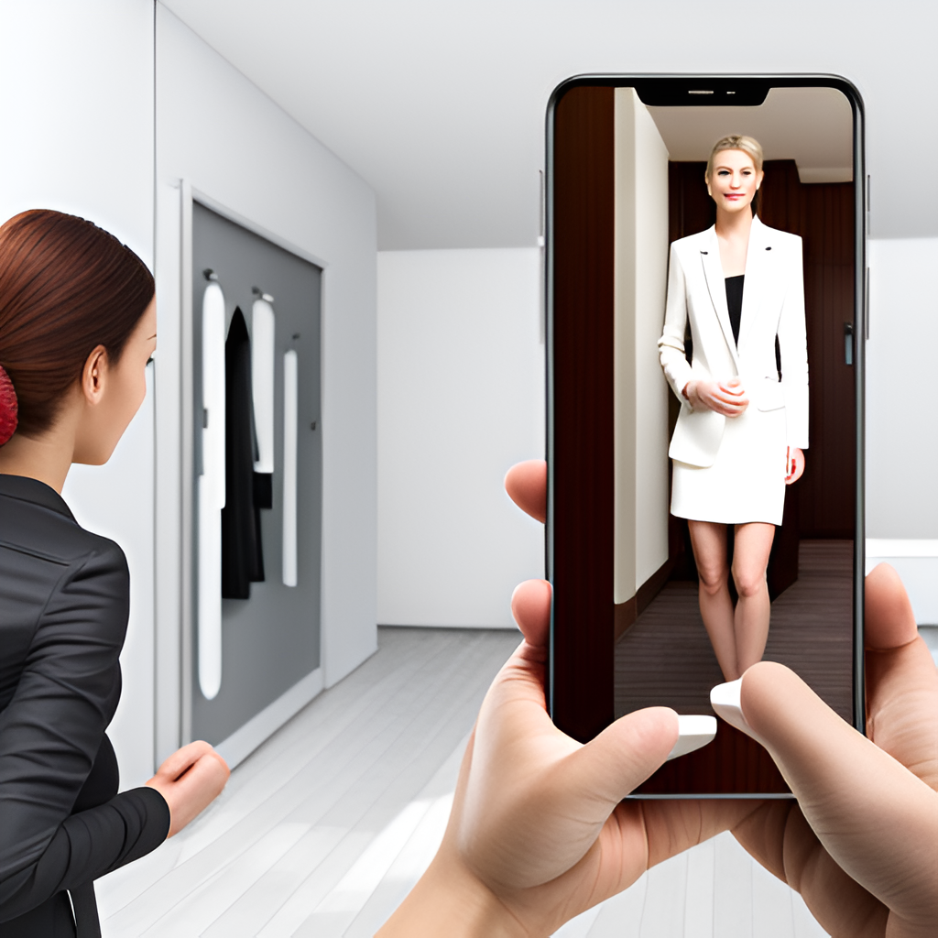
agenda
Revolutionizing In-Store and Online Shopping

Slide 3
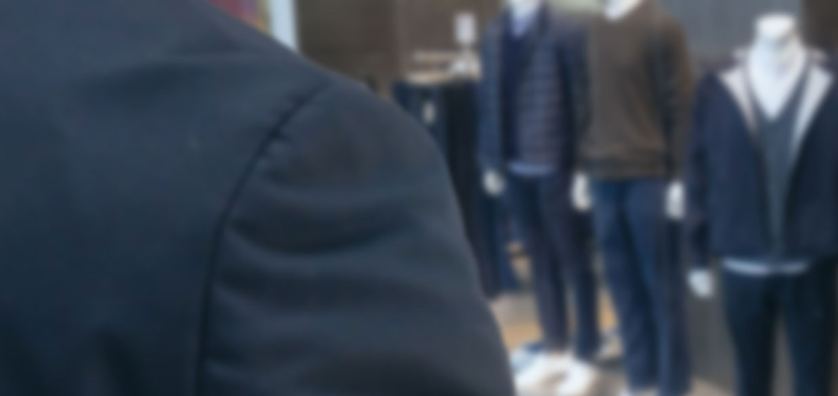
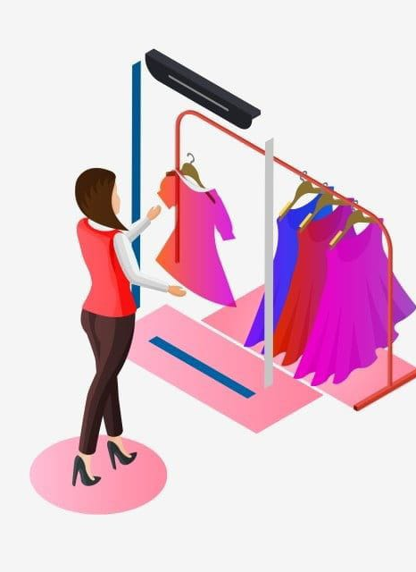
Introduction
Seamlessly combines technology and fashion
To provide a platform for experimenting different cloth styles.
Leveraged the power of computer vision techniques and ML algorithms to seamlessly map shirts onto the user’s body in real-time, delivering an realistic virtual try-on experience

Slide 4
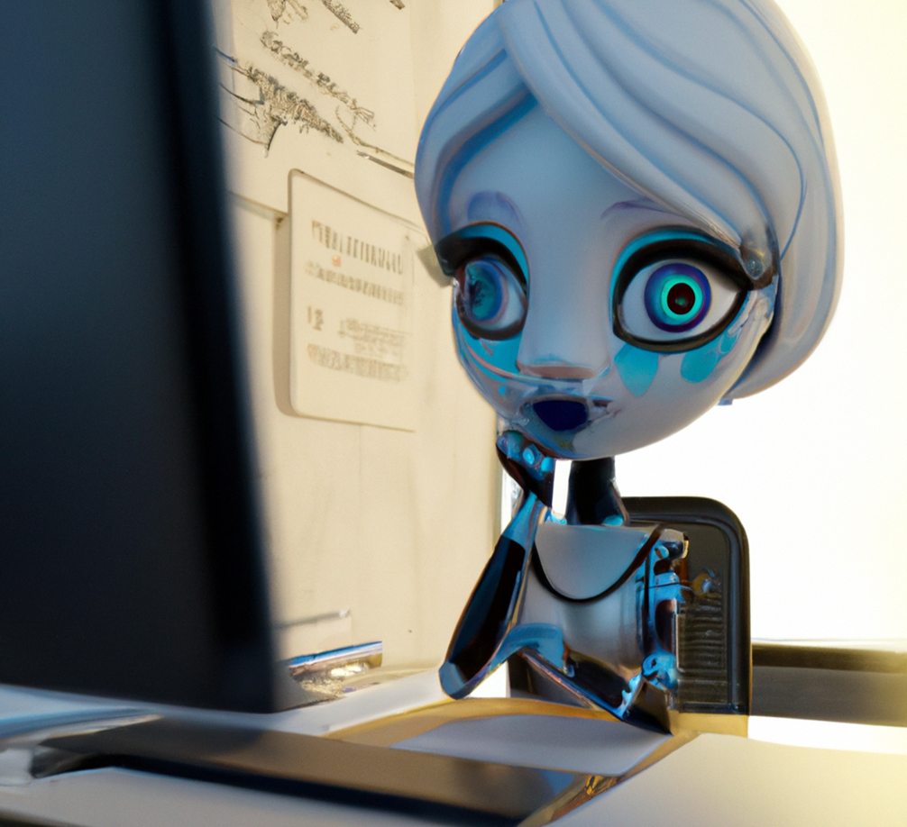
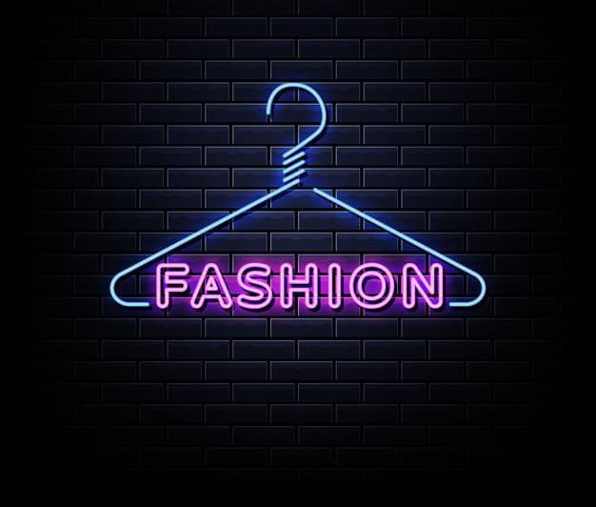
Objectives
1. To improve customer experience.
2. To save the precious time of the customer by this system.
3. To reduce the human effort for trying many clothes in stores.
4. To help retailers save costs by reducing the need for physical try-on rooms and sample sizes.

Slide 5
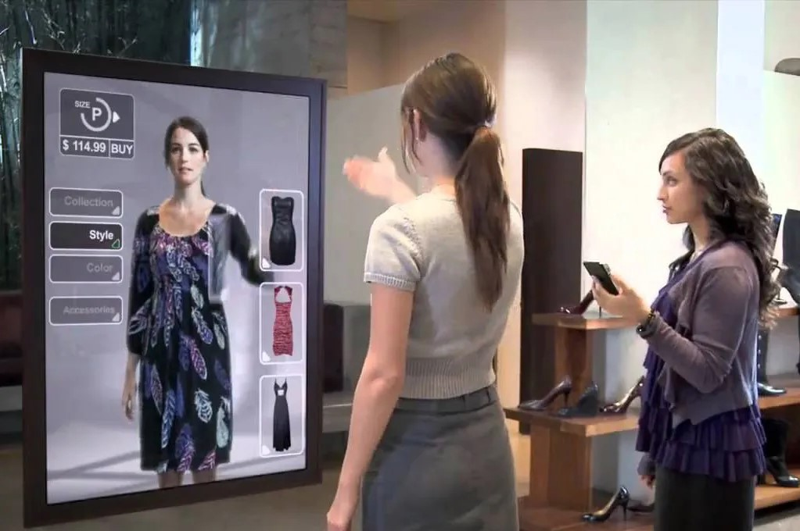
Problem
Problem
Body Detection
Skeleton Tracking
Posture Estimation
Solution
OpenCV
Face Detection
Landmark Detection

Slide 6

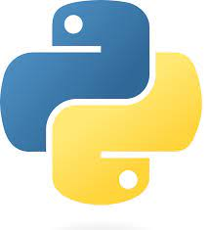
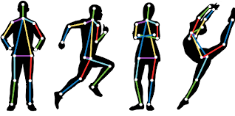
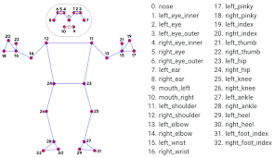
Requirements
Software Requirements:
IDE: PyCharm Community edition
Python 3.9
cvzone OpenCv 4.5.4.60
NumPy
Mediapipe
Hardware Requirements:
A computer/laptop with camera (windows 10 compatible) Intel Pentium IV (500 MHZ or higher)
256 MB of RAM
200 MB of free hard drive space

Slide 7
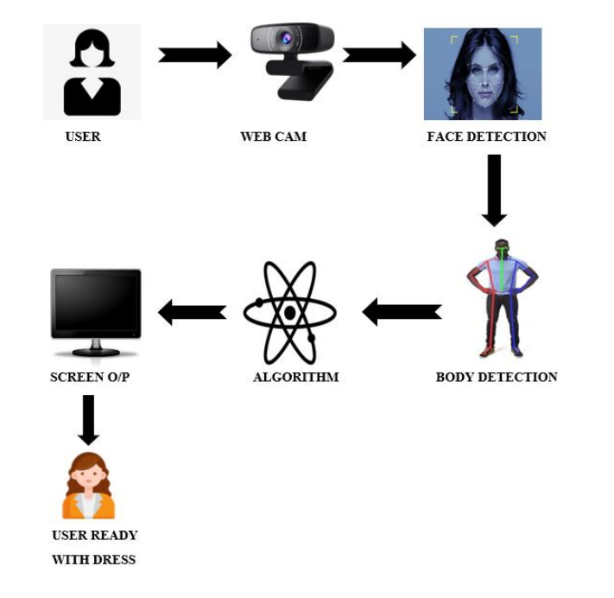
Methodology
Structure (Block Diagram):

Slide 8
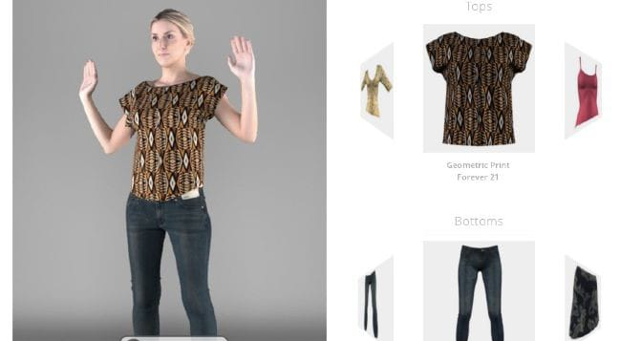
Approach
1. Install packages
Install package
Add Resources
Import Input Video/ webcam
Pose Detection module
fix the position according to scale of overlapped shirt
Scaling

Slide 9
Challenges
Accurate Representation
Real-Time Rendering
Data Acquisition
Integration with E-commerce Platforms

Slide 10
Opportunities
Enhanced Shopping Experience
Personalization and Customization
Sustainability and Reduced Waste
Augmented Reality (AR) Integration
Body Positivity and Inclusivity

Slide 11
Enhancement Scope
E-commerce Integration
Expanded Cloth and Collection
Social Sharing
Room Customization

Slide 12
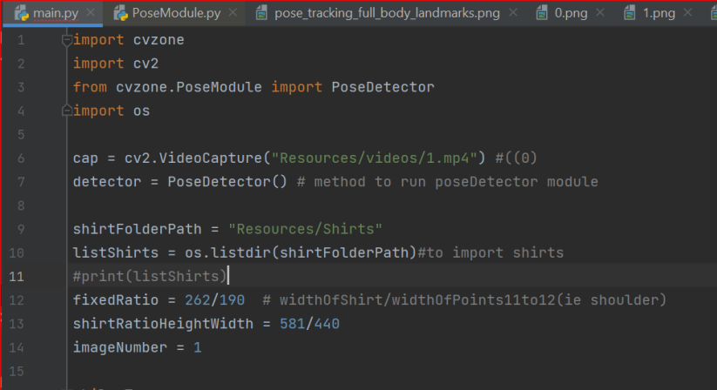
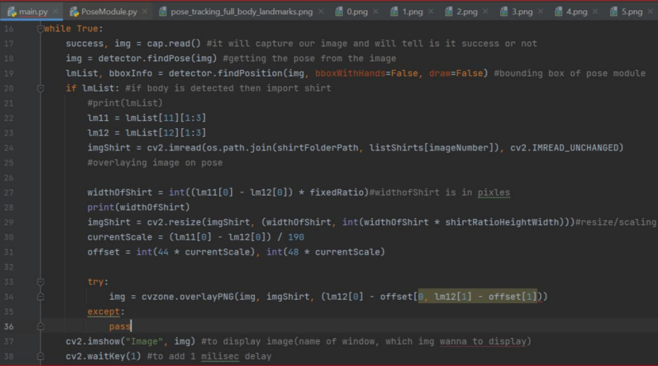
Code

Slide 13
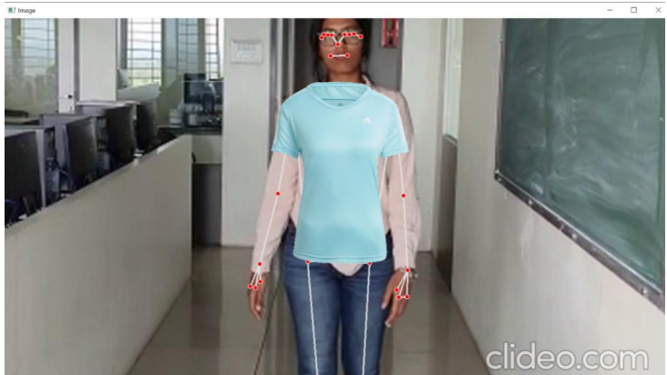
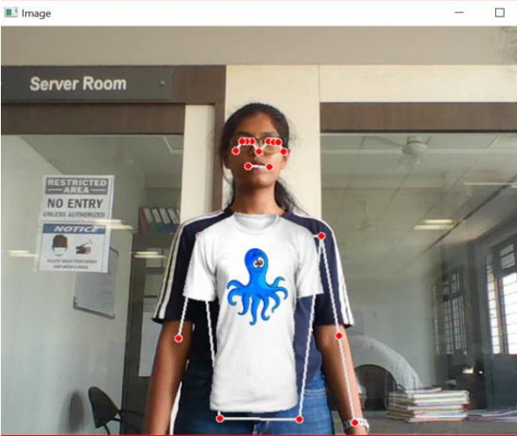
Output
From video
From webcam

Slide 14


